Slide 1

Responder:
A Familiar HTTP Service Framework
Kenneth Reitz

Slide 2
Hi.

Slide 3

@kennethreitz

Slide 4


Slide 5


Slide 6

github.com/kennethreitz
Requests
Responder
Maya
Records
Tablib
httpbin.org
Python-Guide.org
SayThanks.io
'Import This' Podcast
Em Keyboard
Certifi
Autoenv

Slide 8
Pipenv is the porcelain I always wanted to build for pip. It fits my brain and mostly replaces virtualenvwrapper and manual pip calls for me. Use it.
— Jannis Leidel (former pip maintainer)

Slide 9


Slide 10
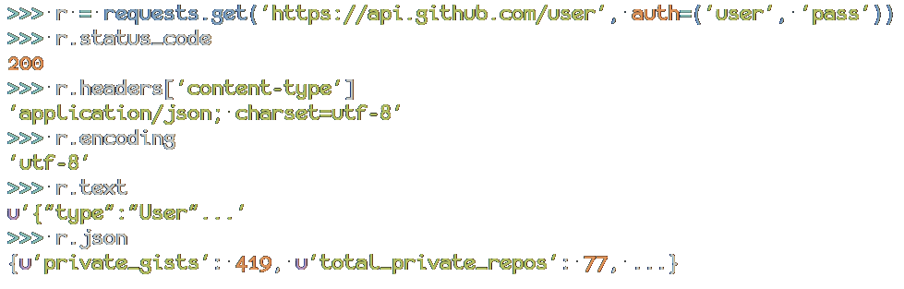

Requests:
HTTP for Humans

Slide 11
Requests is the perfect example how beautiful an API can be with the right level of abstraction.
— Armin Roncher (Flask, etc)

Slide 12
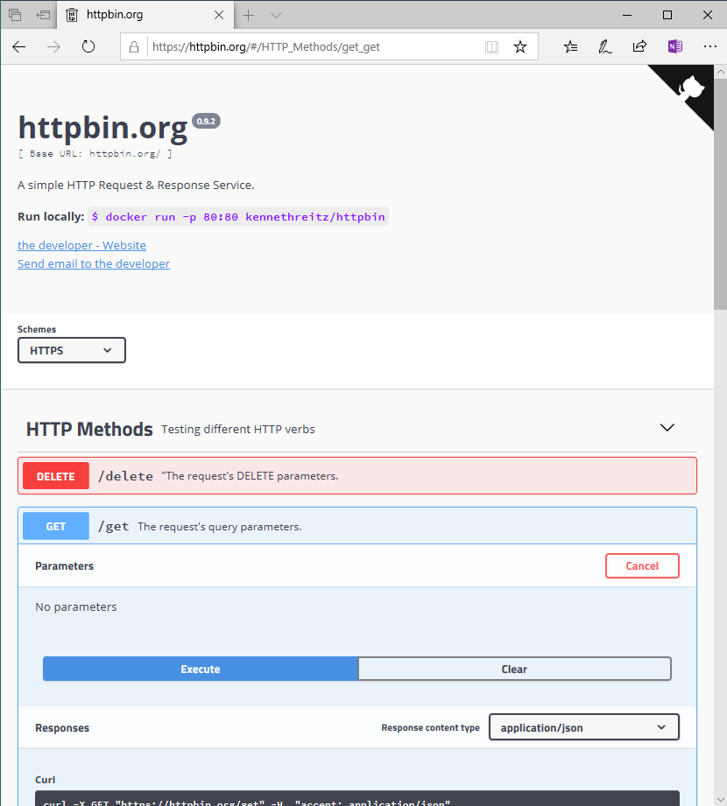

Slide 13

History Time!

Slide 14
1999: Zope + Plone.
Established Python early-on as a serious contender for web development, used heavily in government.
Python 1.5.2 was released in 1999.
Other community tools, like buildout.

Slide 15
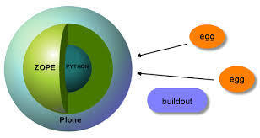
1999: Zope + Plone.

Slide 16

The Rest of the World:
Classic ASP, PHP, Perl, and CGI Scripts.

Slide 17
WSGI
2003

Slide 18
2005: Django.
Sort of a response to Ruby on Rails.
A serious web development framework.
Originally built for a small newspaper in Kansas, it excels greatly at content-driven applications.
Makes a lot of decisions for you (architecture, etc).
Was the de-facto web framework for Python for a long time.

Slide 19
2006: Pylons.
Took the energy of Zope + Plone.
A serious contender to Django.
Allowed you to build things with a more component-oriented architecture than Django.

Slide 20

The Rest of the World:
The Classics + Ruby on Rails.

Slide 21
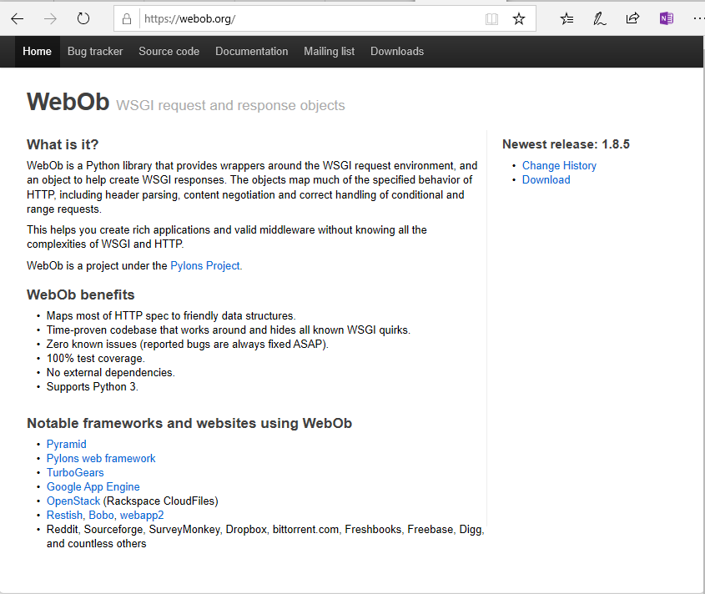
2007: Webob

Slide 22

Honorable Mention: Pyramid.
The reasonable alternative to Django.

Slide 23
Flask.
Everyone’s favorite framework.
Started out as an April Fool’s joke (denied).
“a single file”
Directly inspired by Ruby’s Sinatra.
Grew on popularity due to user-friendliness.
Simple API presented; rarely need to reference the documentation when using it.

Slide 24
The Future
2019+

Slide 25
vs.
Choosing your next project’s web framework…
Flask
Django

Slide 26
Webockets?
Less necessary than you think.
Sever-Sent Events (SSE).

Slide 27
Django Channels
Falcon
Hug

Slide 28
ASGI

Slide 29
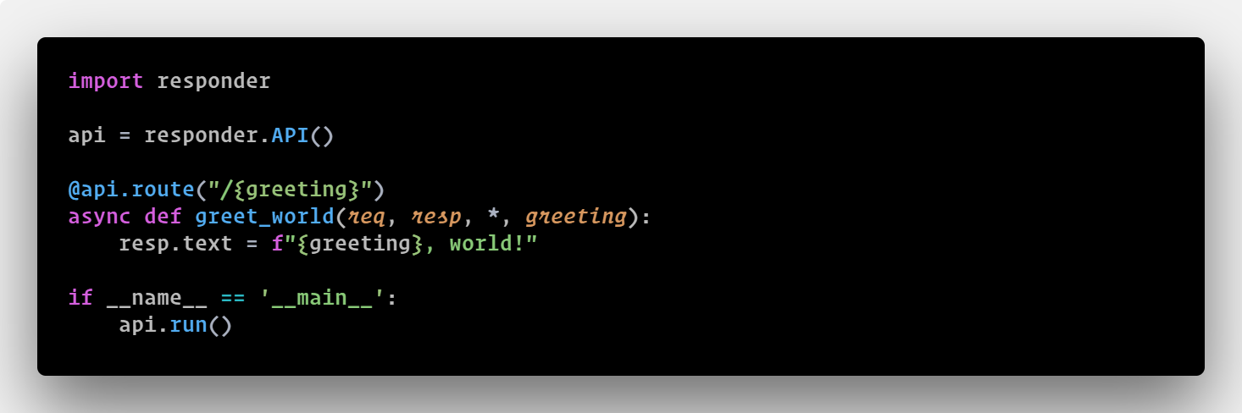

Slide 30
Responder Intentions…
Include Requests as a standard HTTP client.
Base the Request/Response objects very similar to Requests’ own objects.
See if anyone is interested (they seem to be).
Take ourselves seriously.
Make “the world’s best web framework”.

Slide 31
DEMO (Q&A)

Slide 32
Thank you!

Slide 33


